Slide 1

Data science on News data
Axiom
Yichen Wang(Jes)
2019 7.25

Slide 2
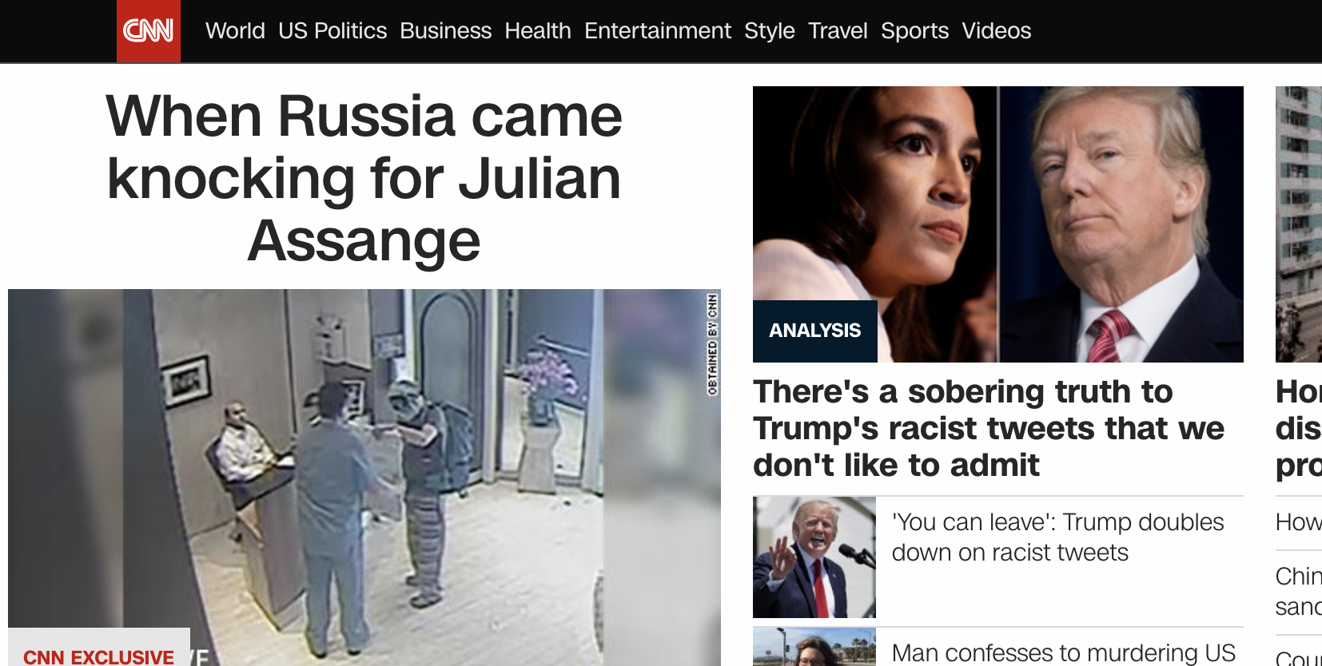
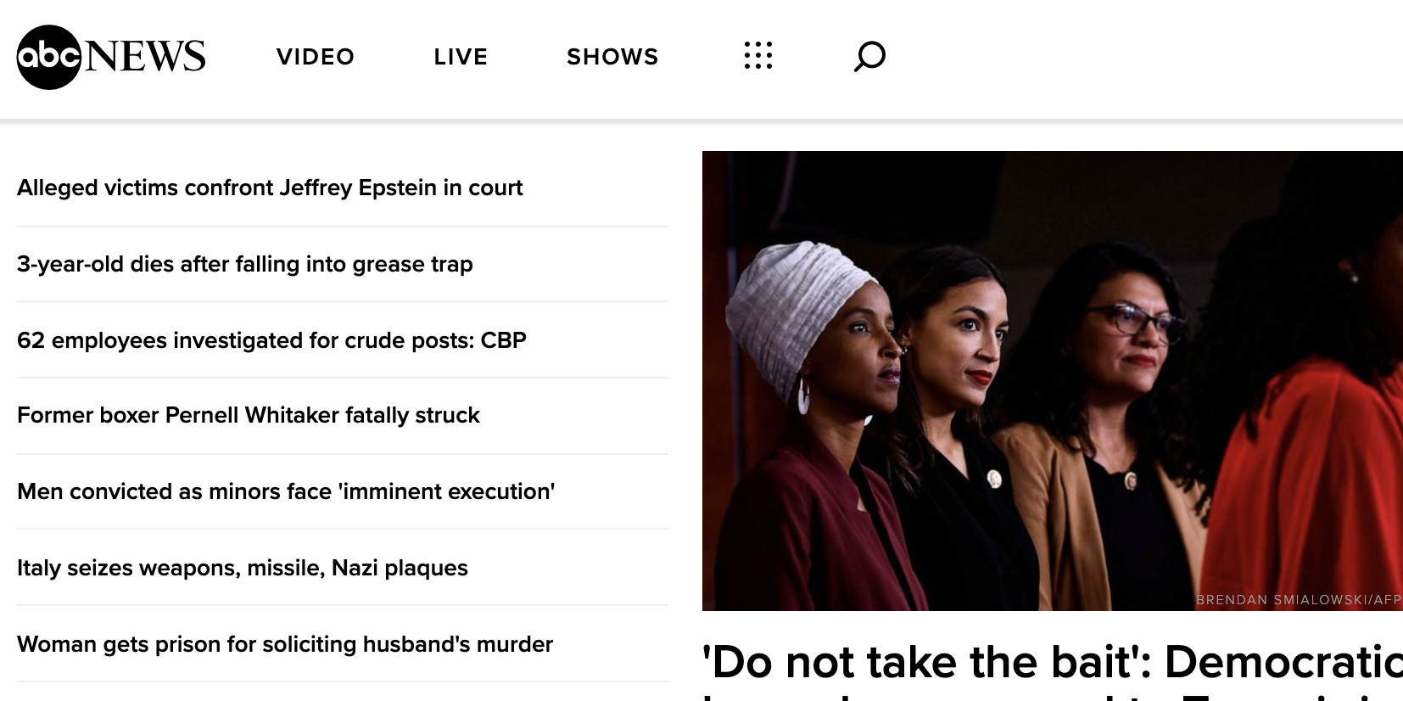

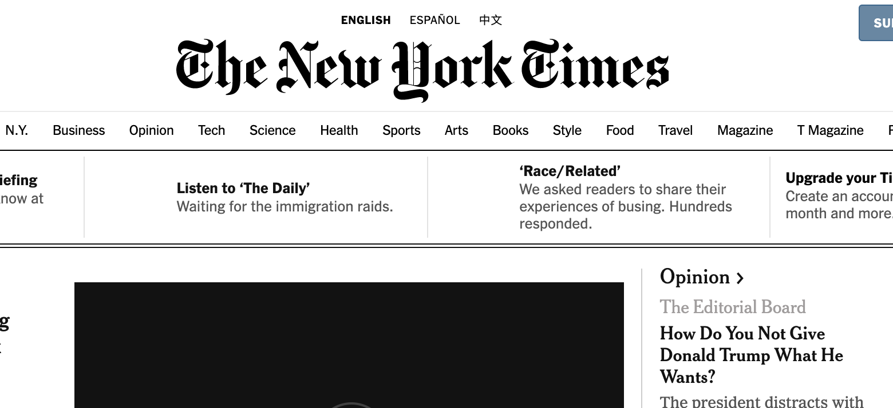
研究背景 Research Background
平面媒体
Printed media
网络媒体
digital Media
便捷获取数据平台

Slide 3
研究目的 research objective
通过对于新闻数据分析以及模型的创建对未来相应的推荐系统提供（从新闻角度）数据的支持。
Through the analysis of news data and the creation of models, it can provide data reference (from the perspective of news) for the corresponding recommendation system in the future.
比如，在准备开店时候的选择， 如果想了解具体的那几个地址是最合适的选择，在参考某一个地址的时候，可以从新闻的数据库来
For example, the choice of 4S stores, if you want to know the specific address when the most appropriate choice, when referring to a certain address, come from the database.
检索相应的地理信息。并通过模型来了解这个地方具体设计的领域以及是否合适。
Retrieve the corresponding geographic information. And through the model to understand the specific design area of this place and whether it is appropriate. 。
维度A
汽车店
维度B
对于参考地理位置在新闻中的表现情况
什么类别，情感分析（正面，负面）
维度C
新闻维度
….

Slide 4
了解了关于新闻数据分析的相关文章。 Understanding the relevant articles on news data analysis.
Kai Shu, Amy Sliva, Suhang Wang, Jiliang Tang, and Huan Liu. 2017. Fake News Detection on Social Media: A Data Mining Perspective. SIGKDD Explor. Newsl. 19, 1 (September 2017), 22-36. DOI: https://doi.org/10.1145/3137597.3137600
Tsoumakas G., Katakis I., Vlahavas I. (2009) Mining Multi-label Data. In: Maimon O., Rokach L. (eds) Data Mining and Knowledge Discovery Handbook. Springer, Boston, MA
Lihong Li, Wei Chu, John Langford, and Robert E. Schapire. 2010. A contextual-bandit approach to personalized news article recommendation. In Proceedings of the 19th international conference on World wide web (WWW '10). ACM, New York, NY, USA, 661-670. DOI=http://dx.doi.org/10.1145/1772690.1772758
W. Zhang and S. Skiena, "Improving Movie Gross Prediction through News Analysis," 2009 IEEE/WIC/ACM International Joint Conference on Web Intelligence and Intelligent Agent Technology, Milan, Italy, 2009, pp. 301-304. doi: 10.1109/WI-IAT.2009.53 URL: http://ieeexplore.ieee.org/stamp/stamp.jsp?tp=&arnumber=5286056&isnumber=5284878
Hu, Yingjie, Xinyue Ye, and Shih-Lung Shaw. 2017. “Extracting and Analyzing Semantic Relatedness between Cities Using News Articles.” International Journal of Geographical Information Science 31(12): 2427–51. https://www.tandfonline.com/doi/full/10.1080/13658816.2017.1367797 (July 15, 2019).

Slide 5
contents
目录
1.0 data scraping
1.0数据爬取
2.0 data cleaning
2.0.数据清理
3.0 data analytics
3.0.数据分析
4.0 machine learning model building
4.0.机器学习模型构建
5.0 Data annotation and exploration with the machine learning model
5.0.机器学习模型的数据注释和探索

Slide 6
1.0 data scraping
1.0 数据爬取
1.1.运用beautiful soup 创建爬取程序对于chinadaily进行 爬取
1.1. Using beautiful soup to create crawlers for chinadaily.
1.2. 对于scrapy运用，并用动态IP解决反爬问题。
1.2. using scrapy, dynamic IP is used to solve the problem of anti-crawling.
1.2.通过extractlink爬取大量数据指定URL的数据。
1.3. Crawl large amounts of data to specify the URL data through extractlink.

Slide 7
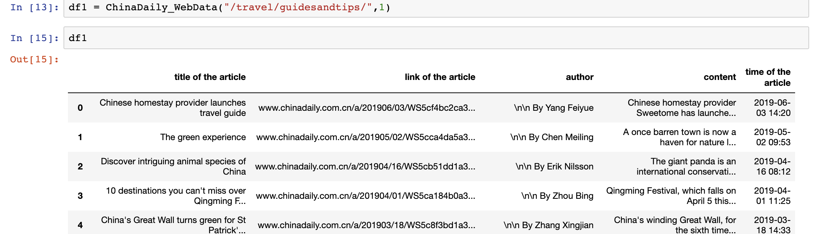
1.1.运用beautiful soup 创建爬取程序对于chinadaily爬取 1.1. Using beautiful soup to create crawlers for chinadaily.
1.运用urllib抓取网站源码信息
1. Using urllib to capture the source information of website
2.用beautiful soap 获取关键信息
2. Getting Key Information with Beautiful soup
3.设置自动翻页
3. Setting up automatic page turning
4.根据url特征选择自己想要爬取的板块和页数
4. Select the plate you want to crawl according to the URL characteristics and page number
https://github.com/axiom-technology-group/project_jes/blob/master/proejct1(6.17)/crawler(bs4)/china%20daily%20data%20scraping%20.ipynb

Slide 8
遇到的问题 problems for the previous method
挑战和问题：beautiful-soap 的整个爬取架构都需要自己创建，另外运用append的方式为单进程，数据爬取的速度受限制。
Challenges and problems: The whole crawling architecture of beautiful-soap needs to be created by itself. In addition, the append approach is used as a single process, and the speed of data crawling is limited.

Slide 9
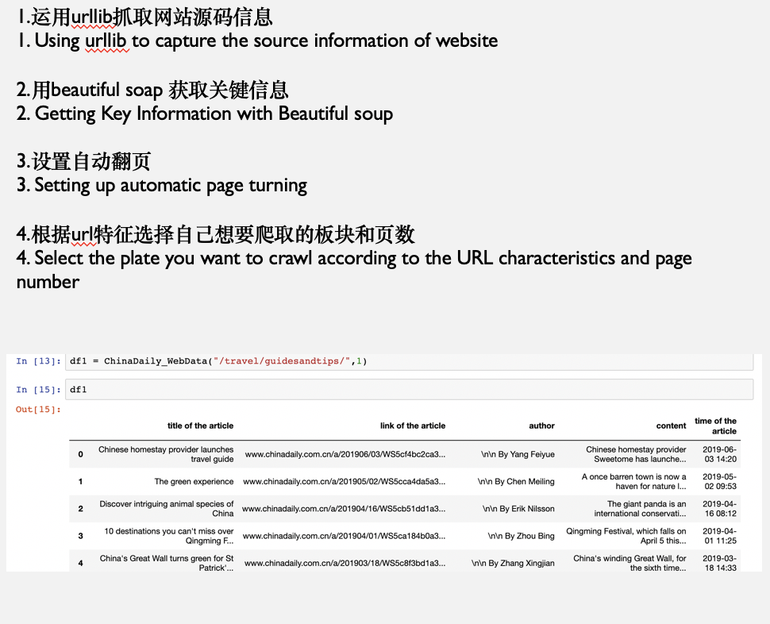
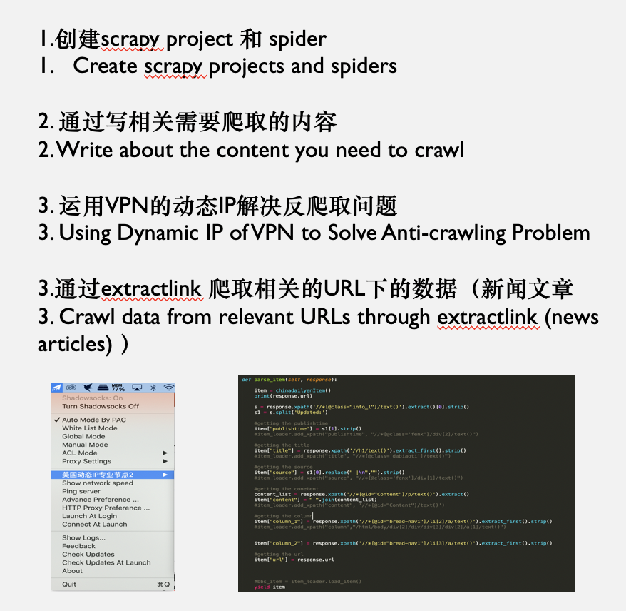
1.2. 对于scrapy运用，并用动态IP解决反爬问题。 1.2. using scrapy, dynamic IP is used to solve the problem of anti-crawling. 1.3.通过extractlink爬取大量数据指定URL的数据。 1.3. Crawl large amounts of data to specify the URL data through extractlink.
https://github.com/axiom-technology-group/project_jes/tree/master/proejct1(6.17)/scrapy/chinadaily/project1

Slide 10
2.0 data cleaning
2.0 数据清理
2.1.清理收集到的数据。清理null values。
2.1. Clean up the collected data. Clean up null values.
2.2.对于文章内的乱码进行清理。使数据规范化。
2.2. Clean up the random code in the article. Standardize data.
2.3.合并文章并抓取有用的信息。（运用pandasDataframe ”group by 把相关数据汇总) 。
2.3. Merge articles and grab useful information. (Use pandas Dataframe"group by to aggregate relevant data).

Slide 11
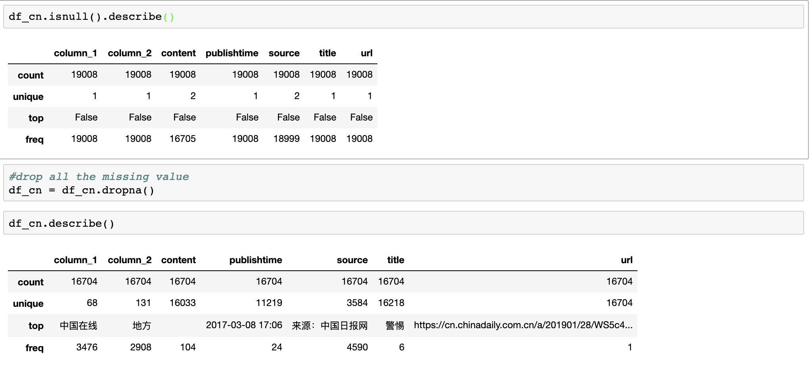
2.1.清理收集到的数据。清理null values。 2.1. Clean up the collected data. Clean up null values.

Slide 12
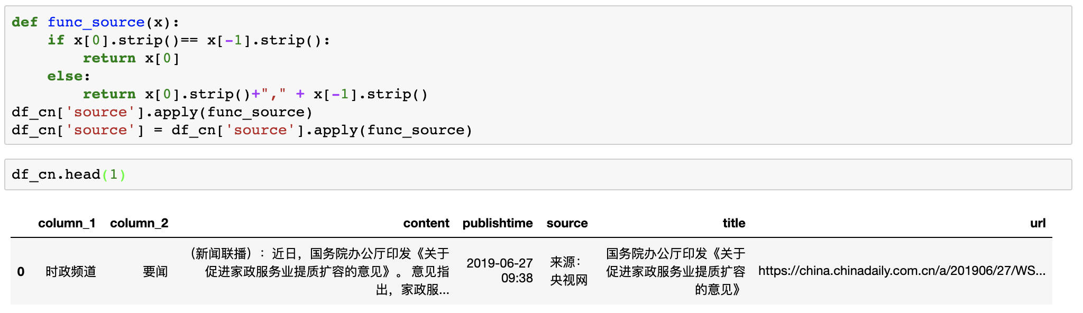
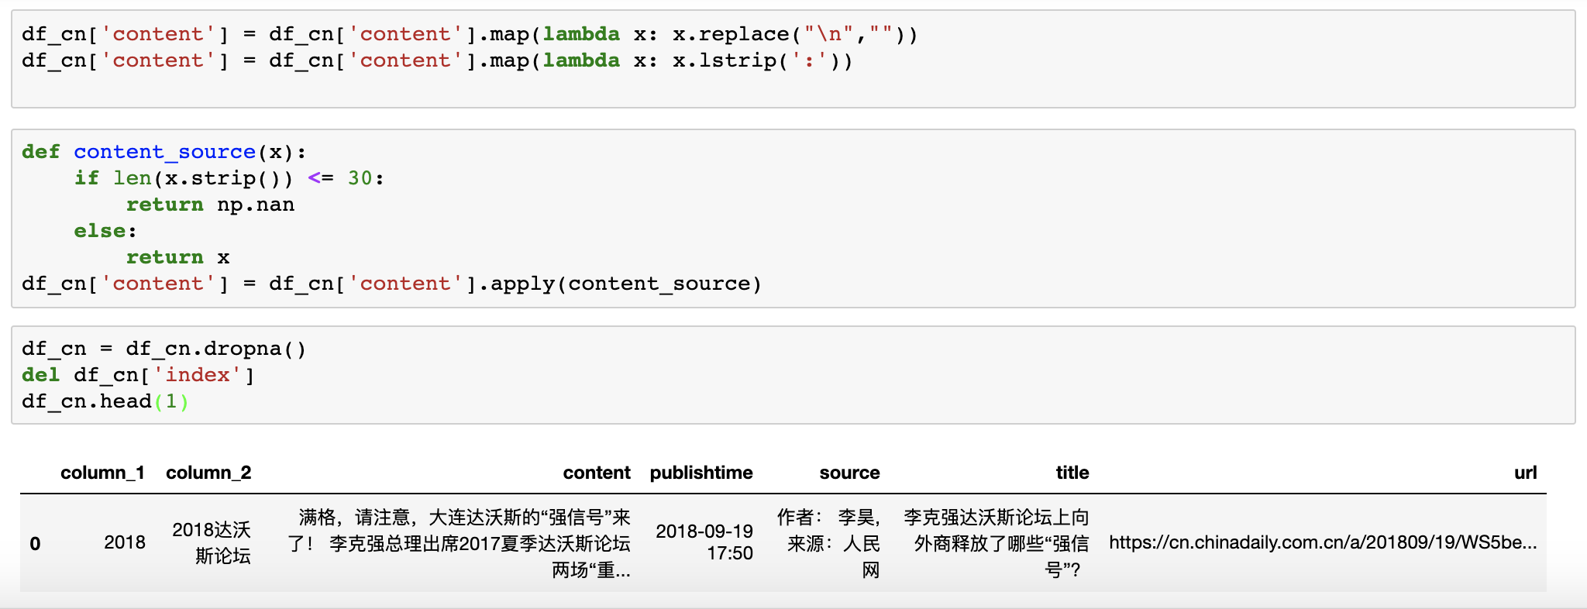
2.2.对于文章内的乱码进行清理。使数据规范化。 2.2. Clean up the random code in the article. Standardize data.

Slide 13
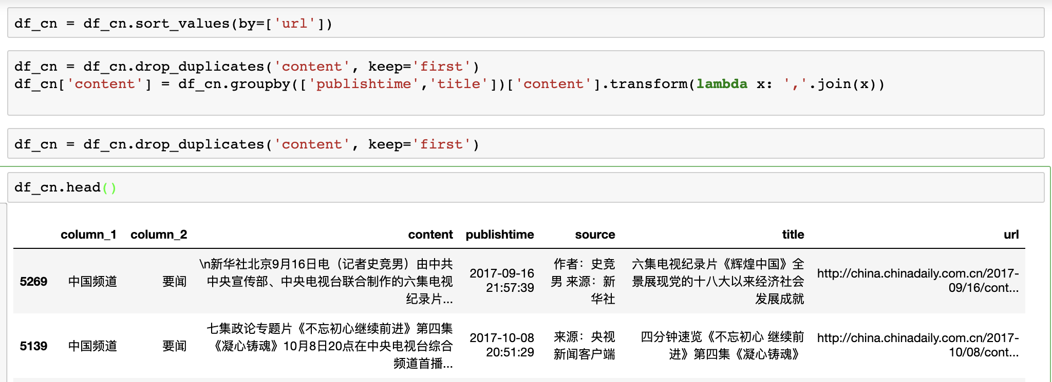
2.3.合并文章并抓取有用的信息。（运用pandasDataframe ”group by 把相关数据汇总) 。 2.3. Merge articles and grab useful information. (Use pandas Dataframe"group by to aggregate relevant data).

Slide 14
3.0 data analytics
3.0 数据分析
3.1. 分词以及词频（jieba）
3.1. Segmentation and word frequency (jieba)
3.2 NLTK 和Spacy分析
3.2 NLTK and Spacy Analysis
3.3 NLP的可视化
3.3 NLP Visualization

Slide 15
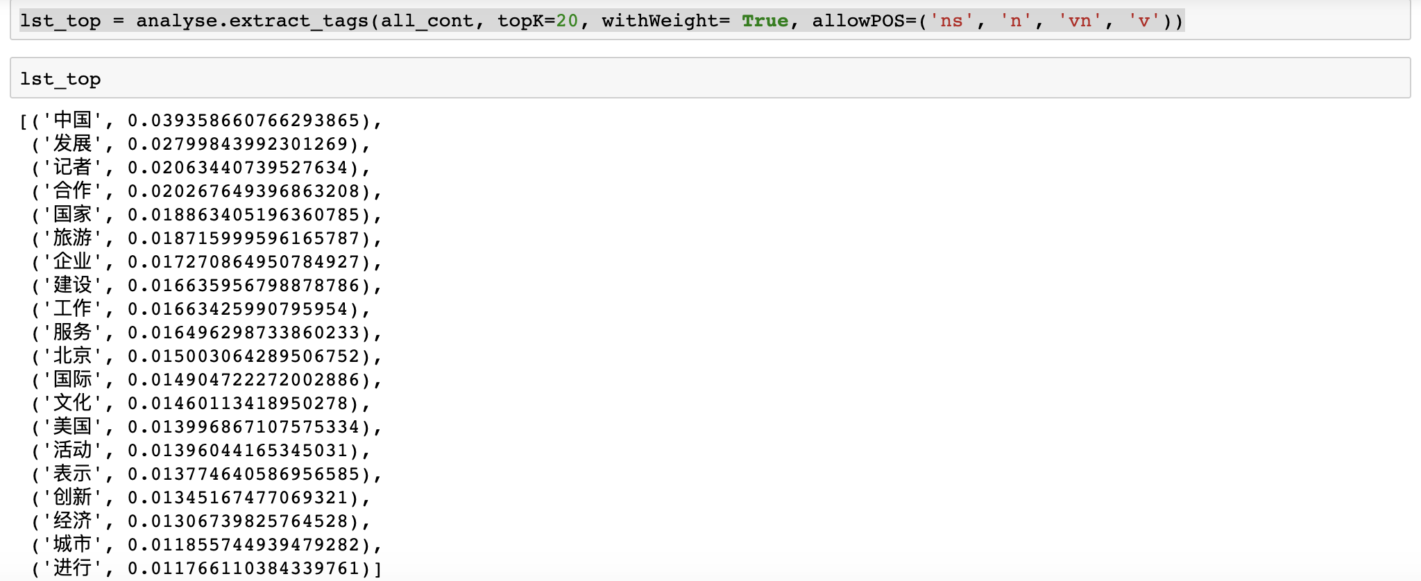
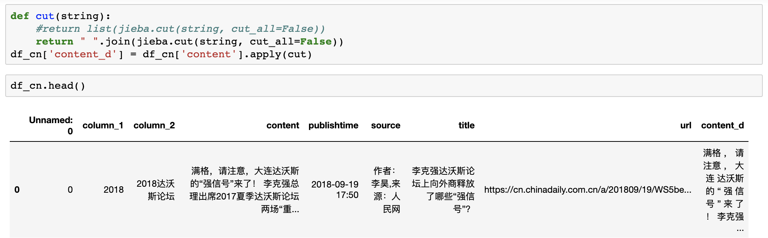
3.1. 分词以及词频（jieba） 3.1. Segmentation and word frequency (jieba)

Slide 16
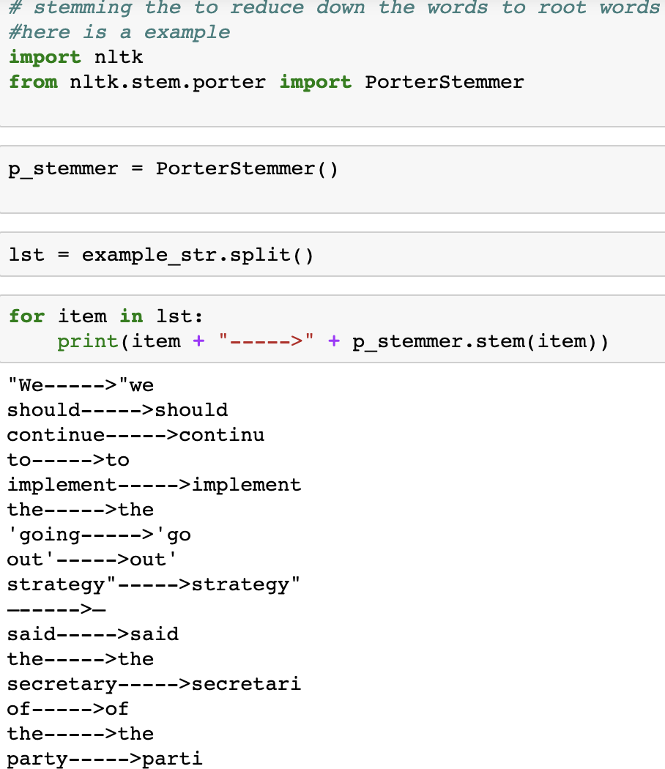
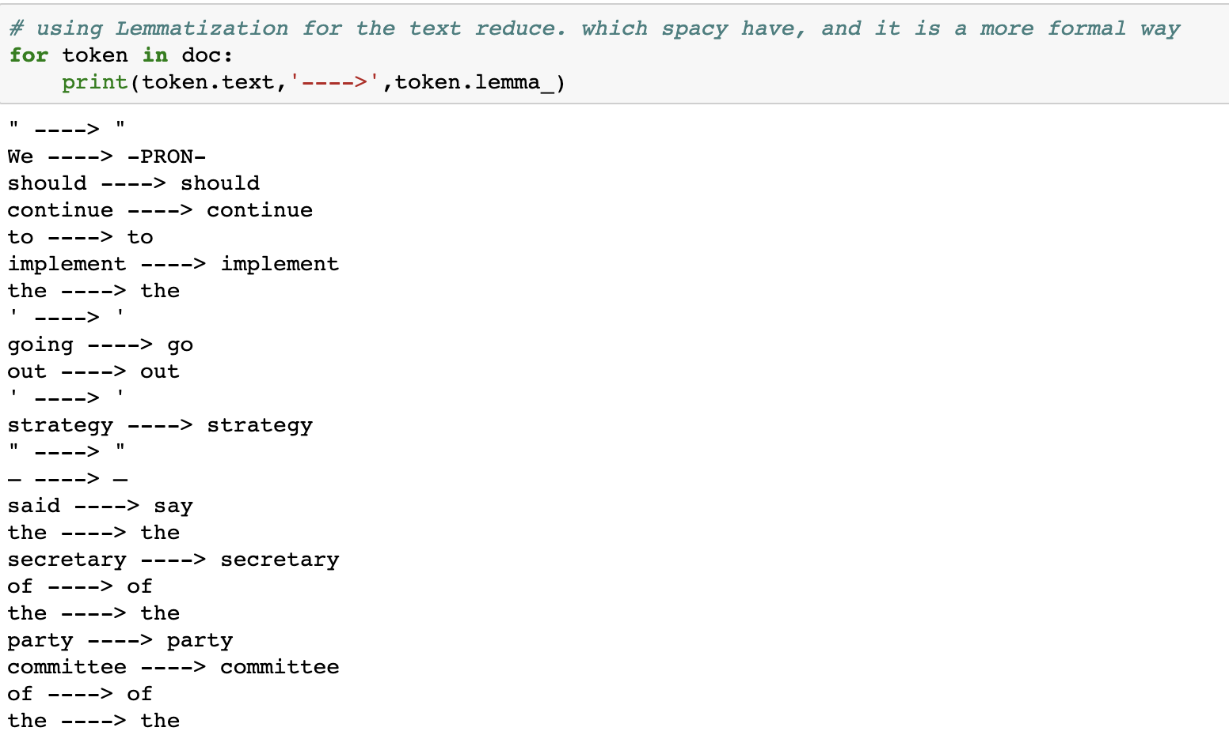
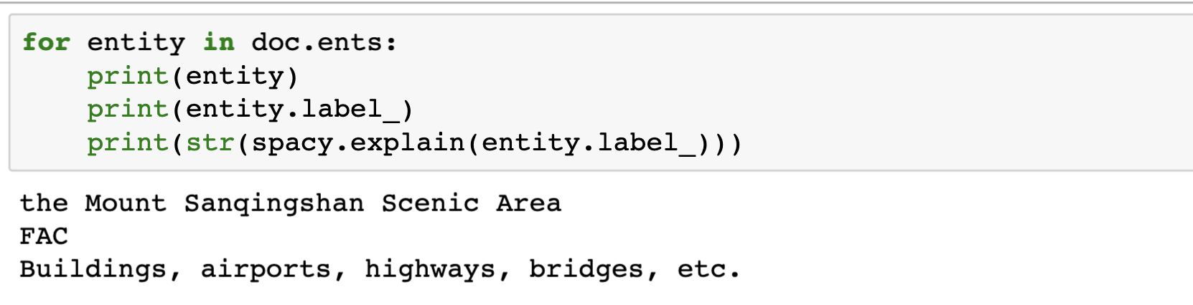
3.2 NLTK 和Spacy分析 3.2 NLTK and Spacy Analysis
Stemming and Lemmatization
Link to machine learning slide
Get the entity

Slide 17
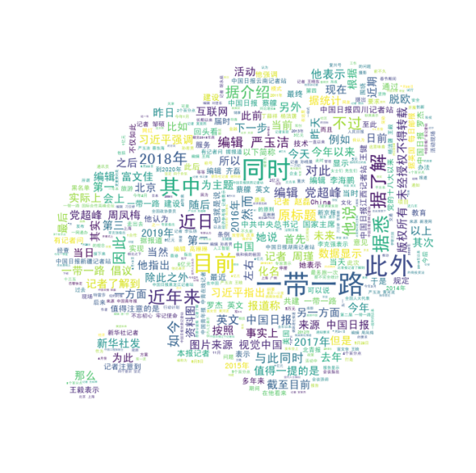
3.3 NLP的可视化 3.3 NLP Visualization
中文新闻
Chinese news

Slide 18
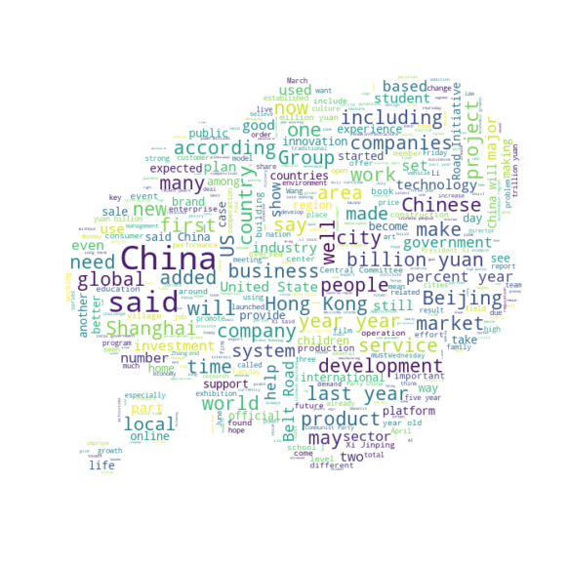
3.3 NLP的可视化 3.3 NLP Visualization
英文新闻
English news

Slide 19
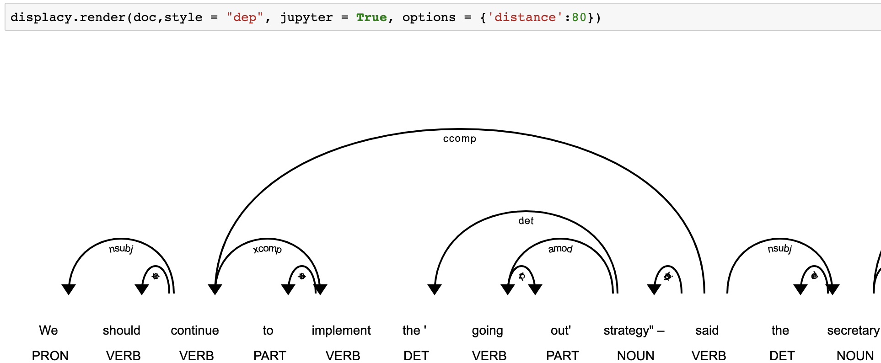
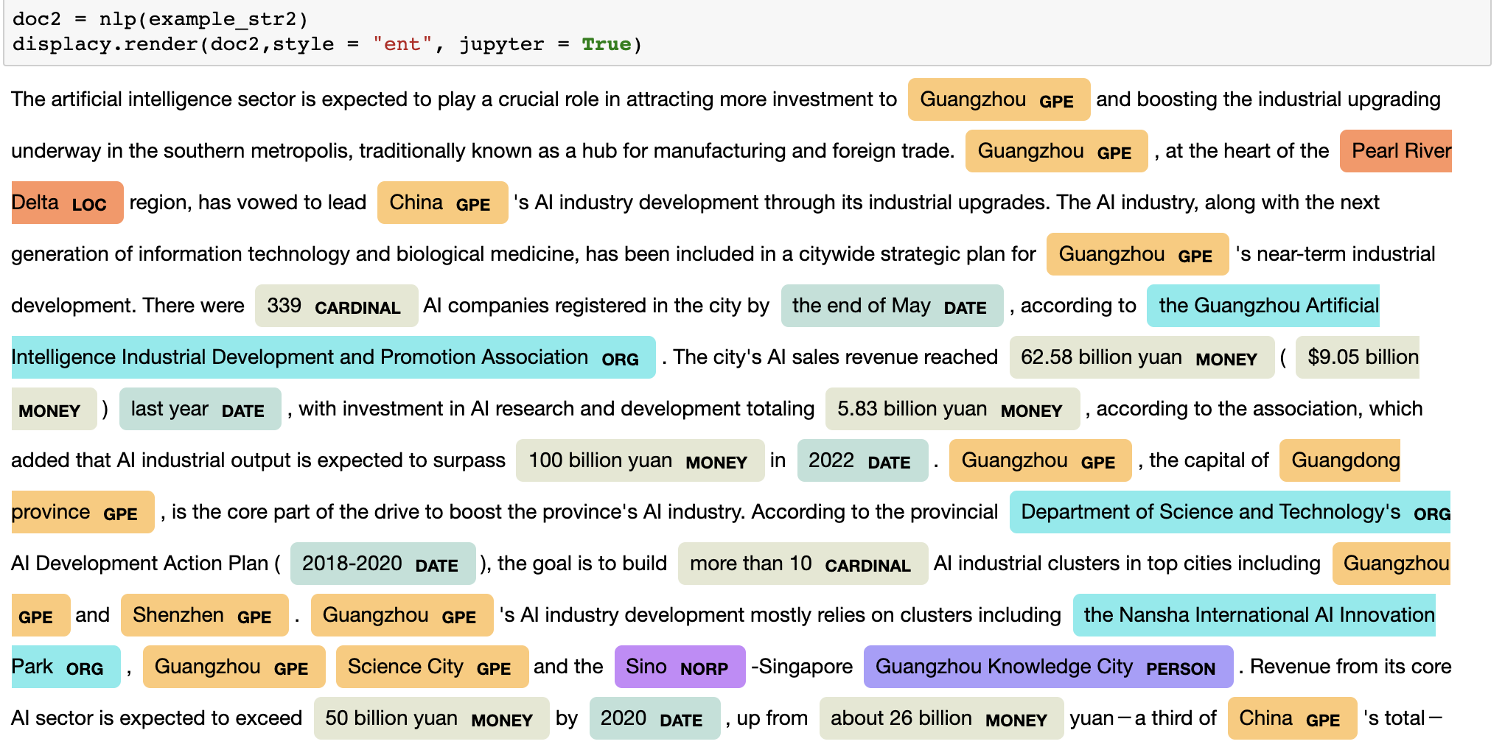
3.3 NLP的可视化 3.3 NLP Visualization
Stanford dependency hierarchy

Slide 20
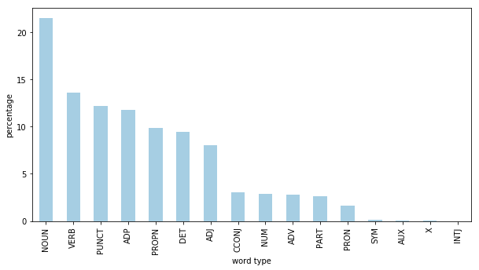
3.3 NLP的可视化 3.3 NLP Visualization

Slide 21
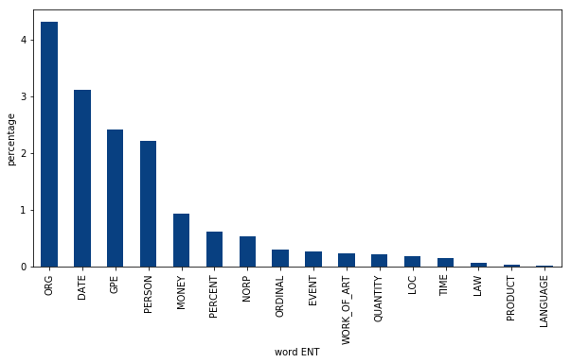
3.3 NLP的可视化 3.3 NLP Visualization

Slide 22
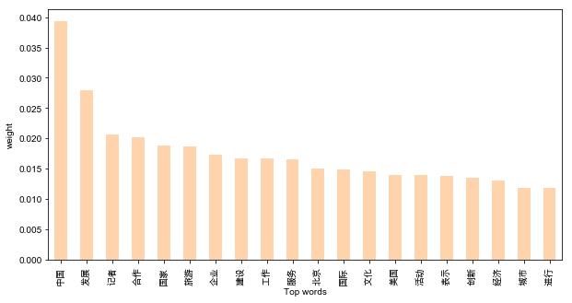
3.3 NLP的可视化 3.3 NLP Visualization

Slide 23
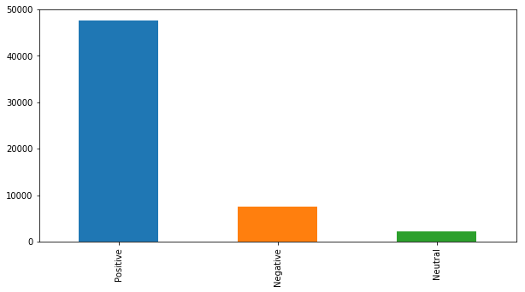
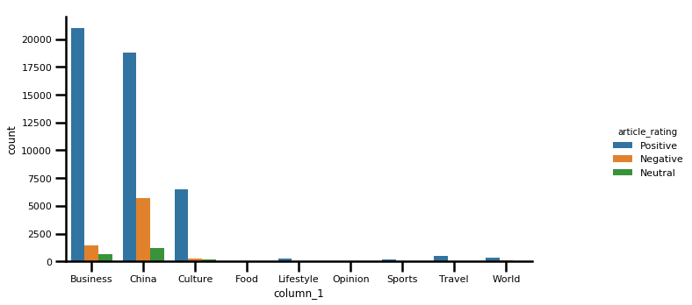
3.3 NLP的可视化 3.3 NLP Visualization
运用vader进行情感分析
sentiment analysis using vader from NLTK
https://github.com/axiom-technology-group/project_jes/tree/master/proejct1(6.17)/1.2%20tokenization%20and%20NLP

Slide 24
4.0 machine learning model building
4.0 机器学习的模型创建
4.1 Sklearn的countvicotizer 和TfidfTransformer。
4.1 Sklearns countvicotizer and Tfidf Transformer.
4.2 对于原有的标签进行二分类的模型建立以及多标签 的模型创建。
4.2 Two-class model building and multi-label model building for the original label.
4.3 通过accuracy score, confusion matrix 和 classification report对于机器学习的不同算法进行分析
4.3 Analysis of different machine learning algorithms through accuracy score, confusion matrix and classification Report

Slide 25
4.0 machine learning model building 4.0 机器学习的模型创建
pipline
原始数据和标签
训练数据和
检验数据分离
Lemmatization
Count vectorizer
Tfidftransformer
(bag of words)
Algorithms
(random forest,
MultinomialNB,
Logistic regression,SVM.)
相关模型
放入训练数据
Y = 相关标签信息
X = 文章相应内容
检验数据进行检验
相对应的结果
Classification report，accuracy score，confusion matrix
https://github.com/axiom-technology-group/project_jes/tree/master/proejct1(6.17)/1.2%20tokenization%20and%20NLP

Slide 26
5.0 Data annotation and exploration with the machine learning model
5.0机器学习模型的数据注释和探索
5.1 根据文章的关键词频对于原始数据进行初分析。
5.1 According to the keyword frequency of the article, the original data are analyzed.
5.2 对于文章进行多维的标注。
5.2 Multidimensional tagging of articles.
5.3 根据样本数据进行多标签以及二分类。
5.3 According to the sample data, multi-label and two-classification are carried out.
5.4 运用原始新闻数据进行交叉验证。
5.4 Cross-validation using original news data.
5.5 未来项目的一些想法以及我对data science的理解。
5.5 Some ideas for future projects and my understanding of data science.

Slide 27
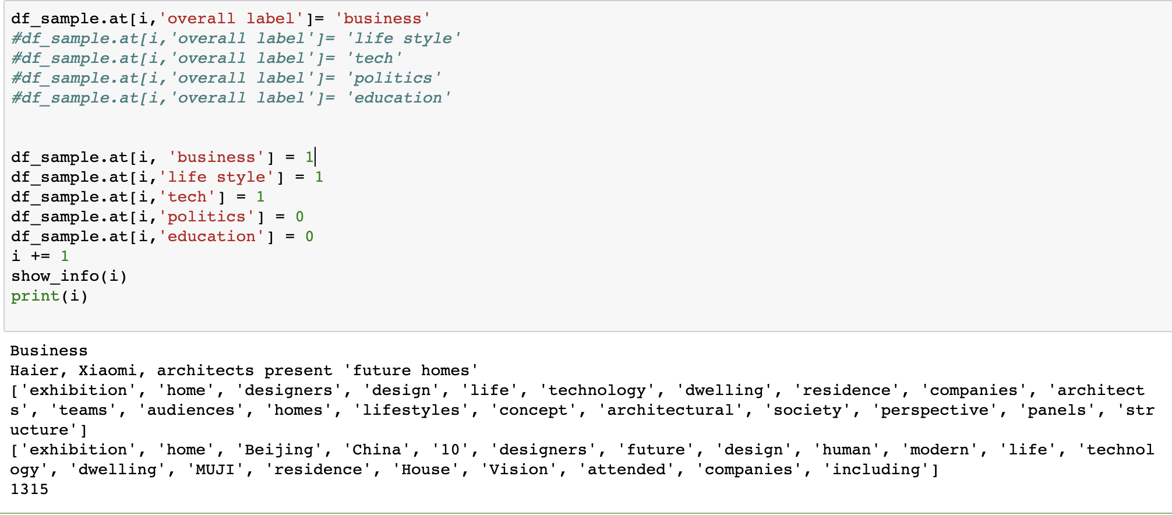
5.0 Data annotation and exploration with the machine learning model 5.0机器学习模型的数据注释和探索
通过抓取文章的标题，高频词可以看出，很多时候一篇文章不仅仅和一个类型的标签相联系，而是和多个标签有关联。
By grabbing the title of the article, high-frequency words can be seen that many times an article is related not only to a type of tag, but also to multiple tags.
比如上面的例子。
For example, the above example.
需要使用多标签分类，和二分类等模型共同使用。将新闻标签多维化
It is necessary to use multi-label classification and binary classification models. Multidimensionalization of News Labels

Slide 28
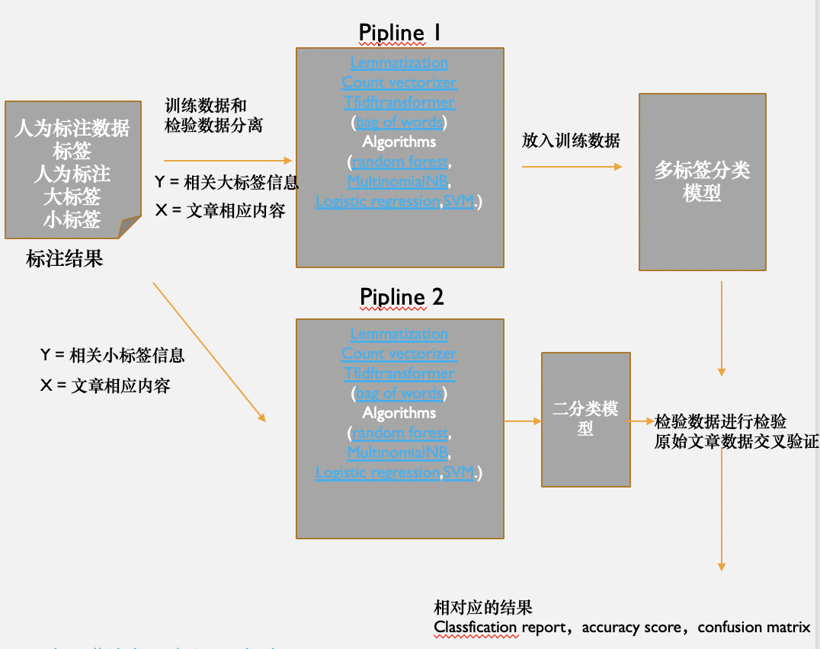
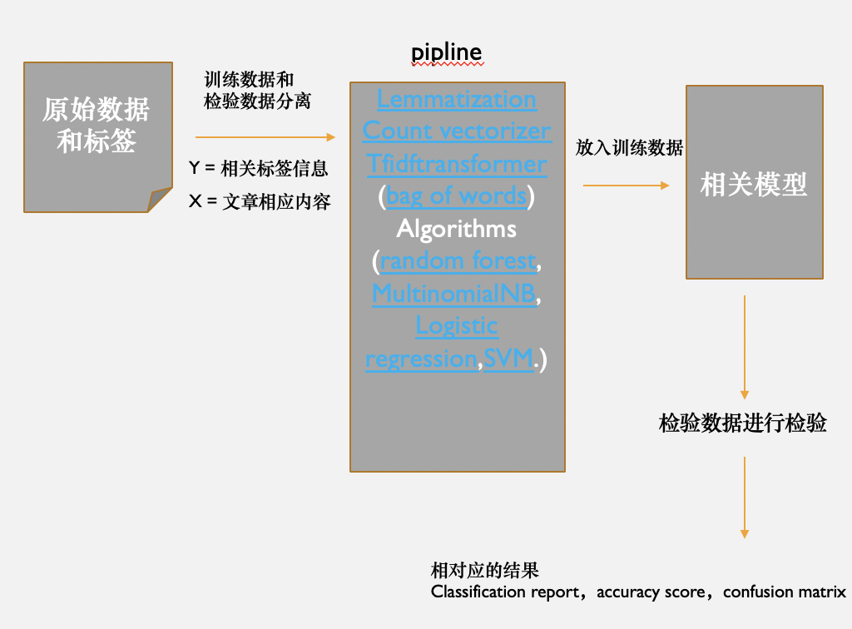
5.0 Data annotation and exploration with the machine learning model 5.0机器学习模型的数据注释和探索
Old model
New model
https://github.com/axiom-technology-group/project_jes/tree/master/proejct1(6.17)/1.3%20articles%20related%20to%20Beijing%20NLP%20and%20modeling
未来的目标和想法

Slide 29
5.0 Data annotation and exploration with the machine learning model 5.0机器学习模型的数据注释和探索
未来的目标和想法
Goals for the next phase
1.机器学习模型的深入. Latent Dirichlet Allocation(LDA)以及Non-negative Matrix Factorization(NMF)等算法创建无监督模型并与之前的模型进行对比研究。
2.调整参数以及深度学习的应用(Pytorch 或者TensorFlow) 对于模型准确度的提高
1. Improving the accuracy of models by adjusting parameters and applying deep learning methods (Pytorch or TensorFlow)
3.大数据的处理以及与地理信息数据接口的创建, 爬取更多的新闻数据，以及地产相关数据，为地理推荐系统做数据上的支持.
3. Processing big data, crawling more news data, and real estate related data to support geographical recommendation system.
对于数据科学的认识：
My Understanding of how to be good at DATA SCIENCE:
Be Passionate
Be diligent in thinking
Be a constant learner

Slide 30
Thanks for listening
Axiom
Yichen Wang(Jes)

Slide 31
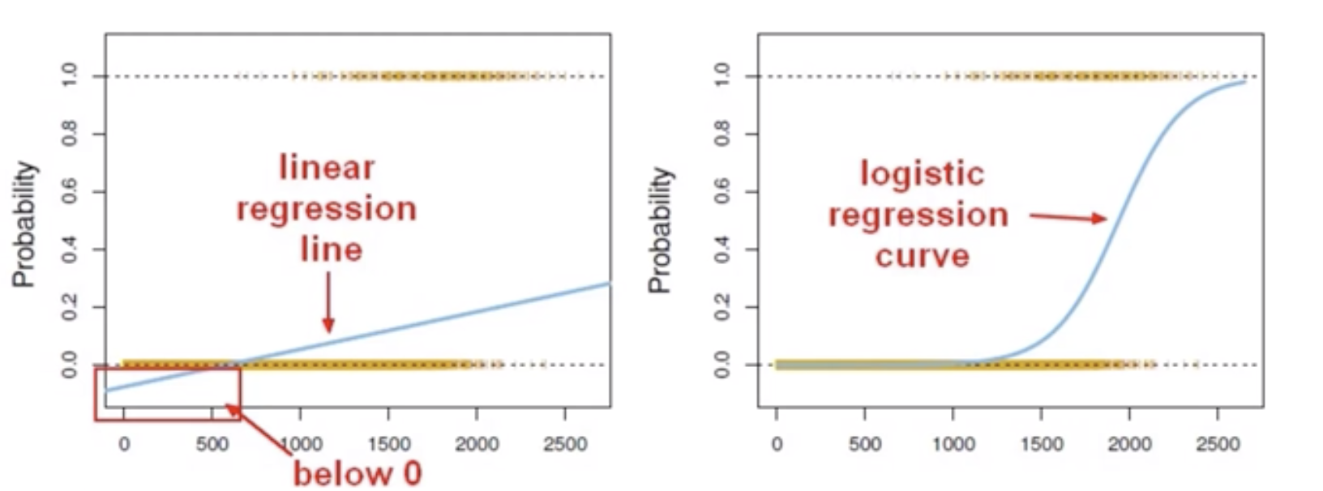
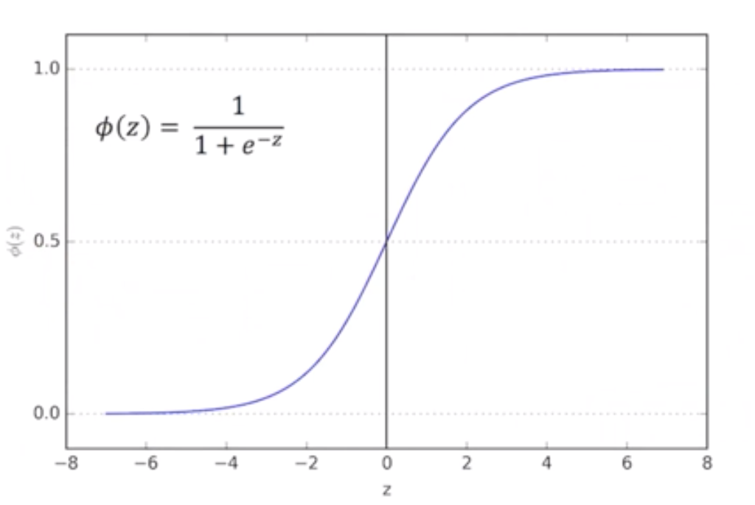
Appendix : logistic regression
Multiclass classification with logistic regression can be done either through the one-vs-rest scheme in which for each class a binary classification problem of data belonging or not to that class is done, or changing the loss function to cross- entropy loss.
back

Slide 32
Appendix : Bag of words model
using the bag-of-words model:
Count how many times does a word occur in each message (Known as term frequency)
Weigh the counts, so that frequent tokens get lower weight (inverse document frequency)
3.Normalize the vectors to unit length, to abstract from the original text length (L2 norm)
back

Slide 33
Appendix : Vectorization
Each vector will have as many dimensions as there are unique words in the SMS corpus. We will first use SciKit Learn's CountVectorizer. This model will convert a collection of text documents to a matrix of token counts.
 | Message 1 | Message 2 | ... | Message N
Word 1 Count | 0 | 1 | ... | 0
Word 2 Count | 0 | 0 | ... | 0
... | 1 | 2 | ... | 0
Word N Count | 0 | 1 | ... | 1
back

Slide 34
Appendix : TF-IDF
the term weighting and normalization can be done with TF-IDF, using scikit-learn's TfidfTransformer.
TF-IDF stands for term frequency-inverse document frequency, and the tf-idf weight is a weight often used in information retrieval and text mining. This weight is a statistical measure used to evaluate how important a word is to a document in a collection or corpus. The importance increases proportionally to the number of times a word appears in the document but is offset by the frequency of the word in the corpus. Variations of the tf-idf weighting scheme are often used by search engines as a central tool in scoring and ranking a document's relevance given a user query.
One of the simplest ranking functions is computed by summing the tf-idf for each query term; many more sophisticated ranking functions are variants of this simple model.
Typically, the tf-idf weight is composed by two terms: the first computes the normalized Term Frequency (TF), aka. the number of times a word appears in a document, divided by the total number of words in that document; the second term is the Inverse Document Frequency (IDF), computed as the logarithm of the number of the documents in the corpus divided by the number of documents where the specific term appears.
TF: Term Frequency, which measures how frequently a term occurs in a document. Since every document is different in length, it is possible that a term would appear much more times in long documents than shorter ones. Thus, the term frequency is often divided by the document length (aka. the total number of terms in the document) as a way of normalization:
TF(t) = (Number of times term t appears in a document) / (Total number of terms in the document).
IDF: Inverse Document Frequency, which measures how important a term is. While computing TF, all terms are considered equally important. However it is known that certain terms, such as "is", "of", and "that", may appear a lot of times but have little importance. Thus we need to weigh down the frequent terms while scale up the rare ones, by computing the following:
IDF(t) = log_e(Total number of documents / Number of documents with term t in it).
See below for a simple example.
Example:
Consider a document containing 100 words wherein the word cat appears 3 times.
The term frequency (i.e., tf) for cat is then (3 / 100) = 0.03. Now, assume we have 10 million documents and the word cat appears in one thousand of these. Then, the inverse document frequency (i.e., idf) is calculated as log(10,000,000 / 1,000) = 4. Thus, the Tf-idf weight is the product of these quantities: 0.03 * 4 = 0.12.
back

Slide 35
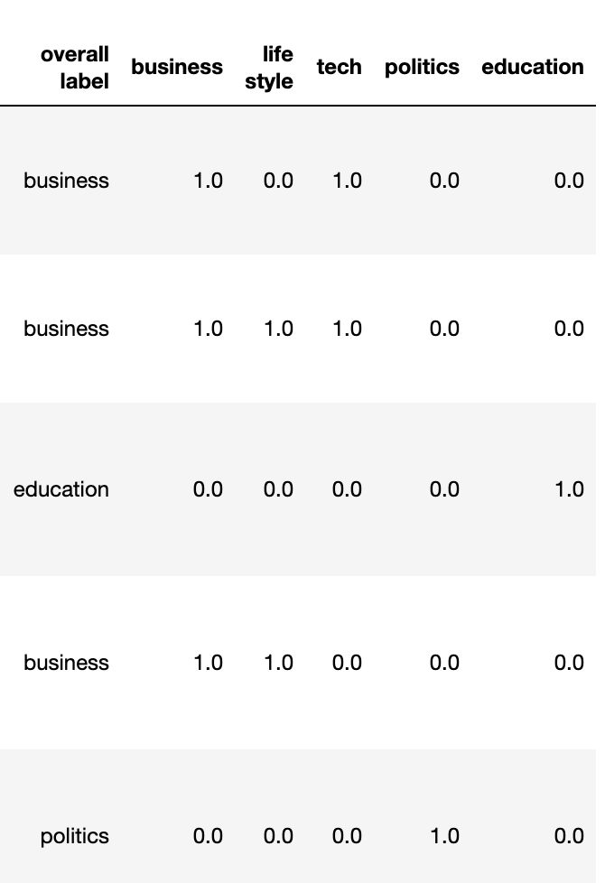
Appendix: result of annotation

